Slide 1
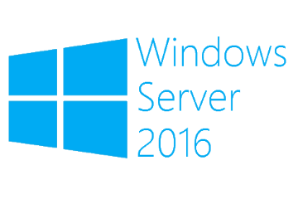
Enhanced Session Mode
Megaseries

Slide 2
Info
In Windows Server 2012 the VMConnect tool that allows you to see the VM screen and give input to it used old technology and lacked a lot of features
In Windows Server 2012 R2 Microsoft introduced Enhanced Session Mode to improve the VMConnect tool
Now VMConnect uses the VM’s RDP protocol over the VMBus to give you a much richer experience
Even though it uses the RDP protocol it does not need the VM to have a NIC or IP configuration (communication is over the VMBus)

Slide 3
Info
Copy/Paste is now fully supported in this new management experience
Redirection of different devices is now supported: smartcards, USB devices, audio and more
Enhanced Session Mode has to be enabled on a Hyper-V host in order for it to be used

Slide 4
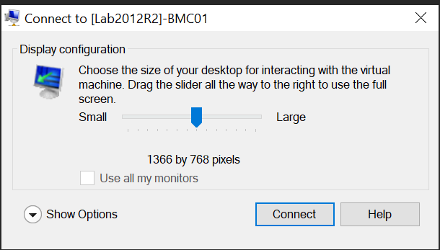
Info
When you open a VM’s console you will get the following prompt:
If you click Connect you will use Enhanced Session Mode (different settings can also be configured)
If you close the dialog you will use the old console with a bitmap image from the emulated video card and emulated mouse/keyboard

Slide 5

https://www.youtube.com/channel/UCcZ-jLbPwNr8E_v9-65n8Iw https://github.com/itknowledge4

